Slide 1
Semantic HTML and Introduction to CSS
Front-End Web Development

Slide 2
Lesson 02 Change Log FEWD 3.1 - 3.2
No changes.
Share how the lesson went through our Instructor Lesson Exit Ticket - the Curriculum Feedback form: http://ga.co/curriculum-feedback

Slide 3
Pre-Class Materials and Preparation
Review all slides, lab activities, and code-alongs.
There are prompts in the speaker notes with opportunities for instructor customization.
Materials
Reference Code
Starter Code in CodePen
Solution Code in CodePen

Slide 4
CSS Basics
Overview
This lesson introduces the syntax of CSS style rules, in addition to how semantic HTML can create synergy with CSS scope.
Learning Objectives
In this lesson, students will:
Choose semantic HTML tags to define and organize content.
Use CSS to apply style to webpages.
Learn the basics of CSS syntax, including selectors and style rules.
Duration: 180 minutes

Slide 5
Suggested Agenda
Time | Activity | Purpose
0:00–0:30 | Semantic HTML | Introduce the concept of container elements in HTML, using specific elements to communicate purpose.
0:30–0:45 | Meatless Burgers | Apply semantic HTML tags to a webpage.
0:45–1:00 | HTML Tables | Tables provide a strictly defined example of parent/child elements and are good semantic HTML examples.
1:00–1:20 | Build a Table | Apply principles of HTML tables to a practical example.
1:20–2:00 | CSS | Introduce the syntax and concepts behind basic CSS rules.
2:00–2:15 | Explaining CSS | Partner exercise push students to explain what they've just learned to others and reveal gaps in understanding.
2:30–3:00 | CSS Exploration | Encourages students to experiment with CSS.

Slide 6

Today’s Learning Objectives
In this lesson, you will:
Choose semantic HTML tags to define and organize content.
Use CSS to apply style to webpages.
Learn the basics of CSS syntax, including selectors and style rules.
6 | © 2020 General Assembly
Notes:
DURATION: 1 minute
TALKING POINTS:
Learning objectives help frame the lesson and give students an idea of what to expect and focus on in the lesson.
TEACHING TIPS:
Explain to students how this lesson fits into the overall course to help them make connections with content from other lessons.

Slide 7
Our First Hands-On Exercise
Front End Web Development

Slide 8
Bovine
Let’s tag an article together!
Our steps are:
Link the HTML, Images, and CSS
Add the content to the html
Tag the content

Slide 9
HTML Warm Up
Front-End Web Development

Slide 10
What Is Front-End Development?
Content
HTML
Style
CSS
Bones
Skin
Interactivity
JavaScript
Brain
Notes:
TALKING POINTS:
HTML is directions to the web browser about what should be displayed on the webpage — i.e., its content.
CSS is the style that’s added to that content.
JavaScript creates interactive elements.
Today, we’ll be practicing with HTML and CSS.

Slide 11
The Anatomy of HTML
Regular Tags
Self-closing Tags (aka Void Tags)
<p>Hello GA</p>
Opening
Tag
Content
Closing
Tag
<img src="picture.jpg" />
<img src="picture.jpg" alt="A picture">
Tag
Attribute
Notes:
TALKING POINTS:
Most elements require content to be placed between opening and closing tags, although some specific elements can be “self-closing” with no corresponding closing tag. This is for typical for elements that link out to external content — you’re not putting anything inside image tags because the image is the content.

Slide 12
Attributes
Attributes are additional information we add to an element.
They appear in the opening tag of the element.
They are made up of two parts: a name and a value, separated by “=”.
<a href=“http://www.amazon.com”>Amazon</a>
Name
Value
Href Attribute
Notes:
TALKING POINTS:
Attributes are additional information we add to an element. They appear in the opening tag of the element and are made of up two parts: a name and a value, separated by an “=” sign.
The attribute name indicates what kind of extra information you’re supplying about the element’s content.
The value is the information regarding the attribute.
The majority of attributes are unique to certain elements. One of these is the anchor element. Here, the href attribute gives us more information about the anchor — it tells the browser where to go when the user clicks on the text.
Additional resource: https://html-css-js.com/html/tutorial/html-tag-attributes.php

Slide 13
Bovine
Let’s tag an article together!
Our steps are:
Link the HTML, Images, and CSS
Add the content to the html
Tag the content

Slide 14
Images
Front-End Web Development

Slide 15
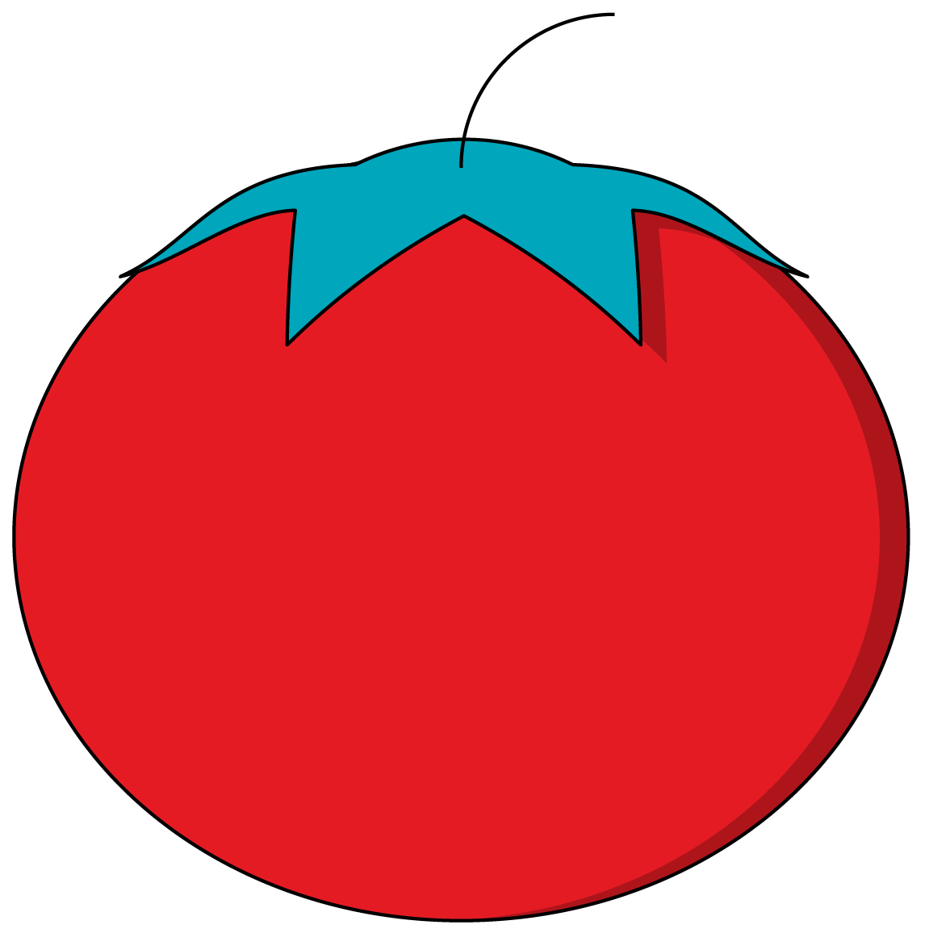
Images
The img tag requires a src attribute, which tells the browser where to find the image.
Notes:
TEACHING TIPS:
Show students the cheat sheet and talk through it a bit.

Slide 16
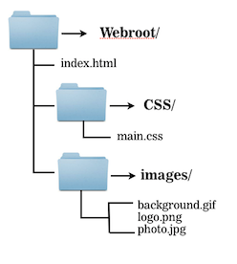
Images
How would you write the src?
There are different approaches to specifying an image location
Notes:
TEACHING TIPS:
Show students the cheat sheet and talk through it a bit.

Slide 17
Images
Relative Path
Absolute Path
<img src="images/logo.png">
<img src="/images/logo.png">
Full URL
<img src="https://ga-core.s3.amazonaws.com/production/uploads/ program/default_image/397/thumb_User-Experience-Sketching.jpg">
Notes:
TEACHING TIPS:
Show students the cheat sheet and talk through it a bit.

Slide 18
Image File Formats
There are 4 major file formats:
JPG / JPEG
PNG
GIF
SVG
Notes:
TEACHING TIPS:
Show students the cheat sheet and talk through it a bit.

Slide 19
Semantic HTML
Front-End Web Development

Slide 20
Common Semantic Elements
Element | Description
main | Indicates the main content of a page.
header | Content placed above and contextualizing the main content.
nav | A navigation section, typically containing links or tabs.
section | Typically indicates one of several, equally placed segments of content.
aside | A sidebar of content placed next to and supplementing an element.
footer | The bottom of a page or section
article | A set of content that can be understood even when extracted from the page
20 | © 2020 General Assembly
Notes:
TALKING POINTS:
Using descriptive tags can help when styling and organizing content on the page.
TEACHING TIPS:
Emphasize there’s no need to memorize all of them — if you see anyone trying quickly to write all of these down, they’ll have way too much they think they need to focus on. All they need to take away is that semantic elements exist and why they should use them.

Slide 21
Semantic HTML
10 minutes
How are the elements in the following HTML nested, and why would a developer write HTML this way?
<nav>
List of Links
</nav>
<main>
<section>
<div>
Content A
</div>
<div>
Content B
</div>
</section>
</main>
21 | © 2020 General Assembly
Notes:
TEACHING TIPS:
Have students turn to the person next to them and come up with answers, then share comments as a class. If teaching remote, use a Slack thread to collect answers instead. Solicit answers involving parent-child-sibling relationships between the <main>, <section>, and <div> tags.

Slide 22

Cheat Sheet: Semantic Elements
It can be confusing to know when to use one element versus another, because they all do the same thing. This flowchart can help you decide.
There isn’t “one right way” to structure HTML. It’s subjective, so do your best.
Notes:
TEACHING TIPS:
Show students the cheat sheet and talk through it a bit.

Slide 23
Meatless Burgers Article
15 Minutes
Let’s recreate a section of a real website using semantic HTML tags.
Starter code:
Exercises and Homework/Lesson 02/02_hamburger/starter_code
Solution code:
Exercises and Homework/Lesson 02/02_hamburger/solution_code
23 | © 2020 General Assembly
Notes:
TEACHING TIPS:
It would be helpful to leave the table of semantic elements from the previous slides visible during this exercise for reference.

Slide 24
HTML Basics
10 minutes
Before moving on to CSS, let’s talk about what we’ve learned about HTML so far.
What are the most important points?
There’s a lot of new information already and lots more to come — it’s important to prioritize and prevent information overload!
24 | © 2020 General Assembly
Notes:
TEACHING TIPS:
Arrange the answers on the board in columns of importance from 1–5.
If teaching remote, collect answers in a Slack thread, then compare them against each other — the more detailed responses can be encapsulated in the broader ideas that are important. Details and specific tags are less important; ideas, and connections between concepts are most important. This should again release pressure on students to memorize/write down every single detail of the content.
Important points to ensure are included in the answers are that HTML is the structure of a site — it’s not programming yet, just raw material for websites. Also, semantics matter: You can get the same content on the page with a large variety of tags, but choosing the right tags will help communicate your intentions more clearly and maintain consistency.

Slide 25
CSS Basics
Front-End Web Development

Slide 26

CSS: Let’s Talk Basics
26 | © 2020 General Assembly
Notes:
TALKING POINTS:
CSS is what makes sites look the way they do.
HTML could simply say we have a “chair,” but CSS is what makes it an egg chair, a La-Z-Boy, an Eames classic… CSS determines the style of the content.

Slide 27
CSS Basics
As we introduce CSS, have this handy reference to the most basic selectors, properties, and values open in a separate browser window.
Reference code:
Exercises and Homework/Lesson 02/03_css_properties
27 | © 2020 General Assembly
Notes:
TEACHING TIPS:
Review the CSS properties and discuss their syntax and/or importance in how they are used to build out designs. Use the code in the walk-through as examples when introducing the following slides.

Slide 28
The Anatomy of CSS
Selector
(What we are styling)
p {
color: blue;
font-size: 20px;
font-style: italic;
}
Declaration Block
(Our styles)
Notes:
TALKING POINTS:
A CSS consists of a selector and a declaration block.
The selector points to the HTML element you want to style.
The declaration block contains one or more directions for how to style that element.
You can have several declarations for one element (font, size, color, alignment).
Each is separated by a semicolons.
Each declaration includes a CSS property name and a value.
A CSS declaration always ends with a semicolon and declaration blocks are surrounded by curly braces.

Slide 29
What Styles Look Like
p {
color: white;
text-decoration: underline;
}
What are the individual parts of this CSS rule?
How do you think we could change or extend them?
What other style changes do you think we could make?
29 | © 2020 General Assembly
Notes:
TALKING POINTS:
Which one is the selector? Value? Property?
TEACHING TIPS:
If teaching remote, create a thread for each one and solicit suggestions for what other selectors/values/properties there might be.

Slide 30
Multiple Selectors
p, q {
color: white;
text-decoration: underline;
}
You can have...
Two selectors together, mixing HTML elements and custom classes if you like. The example above targets p tags and q tags
An unlimited number of selectors can go together — just separate each new selector with a comma.
30 | © 2020 General Assembly
Notes:
TALKING POINTS:
Using multiple selectors is especially effective when the same type of style is repeated throughout a site. If you ever want to change the color, for example, you would typically be changing it in all other places where the same color was chosen as part of altering the theme of the site.

Slide 31
Parent Selectors
p a {
color: white;
text-decoration: underline;
}
You can target elements according to their specific parent element by separating two selectors with a space. The example above targets all a tags contained within a p tag.
There are also other selectors, called combinators, that target elements based on their specific relationships to other elements.
31 | © 2020 General Assembly
Notes:
TALKING POINTS:
Parent selectors are commonly used to target specific areas of the site. Targeting an element based on it’s path adds to its specificity and increases its weight when compared to other rules applied to the same type of element.
Find out more about combinators here: https://www.w3schools.com/css/css_combinators.asp.

Slide 32
General Selectors
Specific Selectors
Cascades Throughout HTML
Hit Limited Amount of Elements
Using selectors that are generic, i.e., represent a “trunk” of the tree, will result in styles that cascade and affect many elements.
Good uses: Color themes, font styles, and other stylistic elements repeated throughout the site.
Classes and IDs are useful for styles that are only applied in small, limited sections of the website.
Good uses: The spacing and placement of individual elements and styling of non-repeated elements.
32 | © 2020 General Assembly

Slide 33
Properties
p {
color: white;
text-decoration: underline;
}
Properties are parts of the CSS spec that control style behavior. Most are logically named, but not all.
Properties will always be followed by a colon, then the value.
33 | © 2020 General Assembly

Slide 34
Properties + Values
p {
color: white;
}
In this example, all p tags are having their color property set to the value of white. This changes their font color to the given value.
You must have at least one property/value pair per selector (otherwise, nothing happens). And they MUST end with a semicolon — always!
34 | © 2020 General Assembly

Slide 35
Properties + Values
p {
color: white;
font-weight: bold;
padding: 15px;
text-decoration: underline;
}
You can have an unlimited amount of property/value pairs in a style declaration.
If you find that many declarations share the same property/value pairs, consider declaring that property/value pair in a more broadly targeted selector.
35 | © 2020 General Assembly
Notes:
TEACHING TIPS:
This can be a good opportunity to introduce the “Don’t Repeat Yourself” mantra.
TALKING POINTS:
If color:white is listed for 10 different elements in 10 different places, for example, that single rule should be in a single declaration impacting all 10 of the desired elements. That way, changing it to a different color throughout the site will be easier and you’ll be less prone to “missing a spot.” This is a perfect use case for creating a class called .white.

Slide 36
There Is a Whole Universe of CSS Properties and Values
A good dev knows what planet they are on.
36 | © 2020 General Assembly
Notes:
TEACHING TIPS:
Emphasize again that attempting to memorize every CSS property and its possible values would be a bad use of time. Knowing the most commonly used ones and how to quickly research the less-common ones when needed is the essential skill to take away.

Slide 37
Defining Colors
Colors are used throughout the CSS spec for a variety of properties.
Colors can be specified in a variety of ways.
37 | © 2020 General Assembly

Slide 38
Color Keywords
p {
color: white;
}
Colors can be defined by a keyword built into the CSS spec.
Aside from black and white, they aren’t used much.
38 | © 2020 General Assembly

Slide 39
Color in RGB
p {
color: #ffdb00;
}
p {
color: rgb(255,219, 0);
}
Colors can be defined by the combination of red, green, and blue.
RGB is additive - combine all the colors to get white.
RGB can be defined either in arabic numbers (0-255) or base-16 hexadecimal numbers (0-FF).
39 | © 2020 General Assembly

Slide 40
RGBA - Adding Transparency
RGBa works identically to RGB, expect that it takes a 4th value called the "alpha".
This is a value between 0 and 1 which will be used to determine a color's opacity on the page,
40 | © 2020 General Assembly

Slide 41
Important CSS Properties
Property Name | Description
background, background-color | The style behind an element; can be images, colors, or gradients.
border | Styles the edges around an element.
color | Sets the color of text, NOT the background color!
font | Controls font family, size, style, and weight.
height, width | Sets how tall or wide an element should be in px, %, or ems.
margin | Creates space outside of an element.
padding | Creates space on the inside border of an element.
text-align | Defines the direction that text lines up in an element.
41 | © 2020 General Assembly
Notes:
TEACHING TIPS:
Of course there are more or less on each developer’s individual list, so these are by no means the most important CSS properties. Reiterate that students will get a sense for which ones are important based on which they’re using the most often and seeing the most often when inspecting sites in their browser.

Slide 42
Press Release
15 Minutes
Let’s style a press release
Starter code:
Exercises and Homework/Lesson 02/04_press_release/starter_code
Solution code:
Exercises and Homework/Lesson 02/04_press_release/solution_code
42 | © 2020 General Assembly
Notes:
TEACHING TIPS:
You can also encourage students to make changes to the rules and see what happens — experimentation will be key to exploring these early concepts.

Slide 43
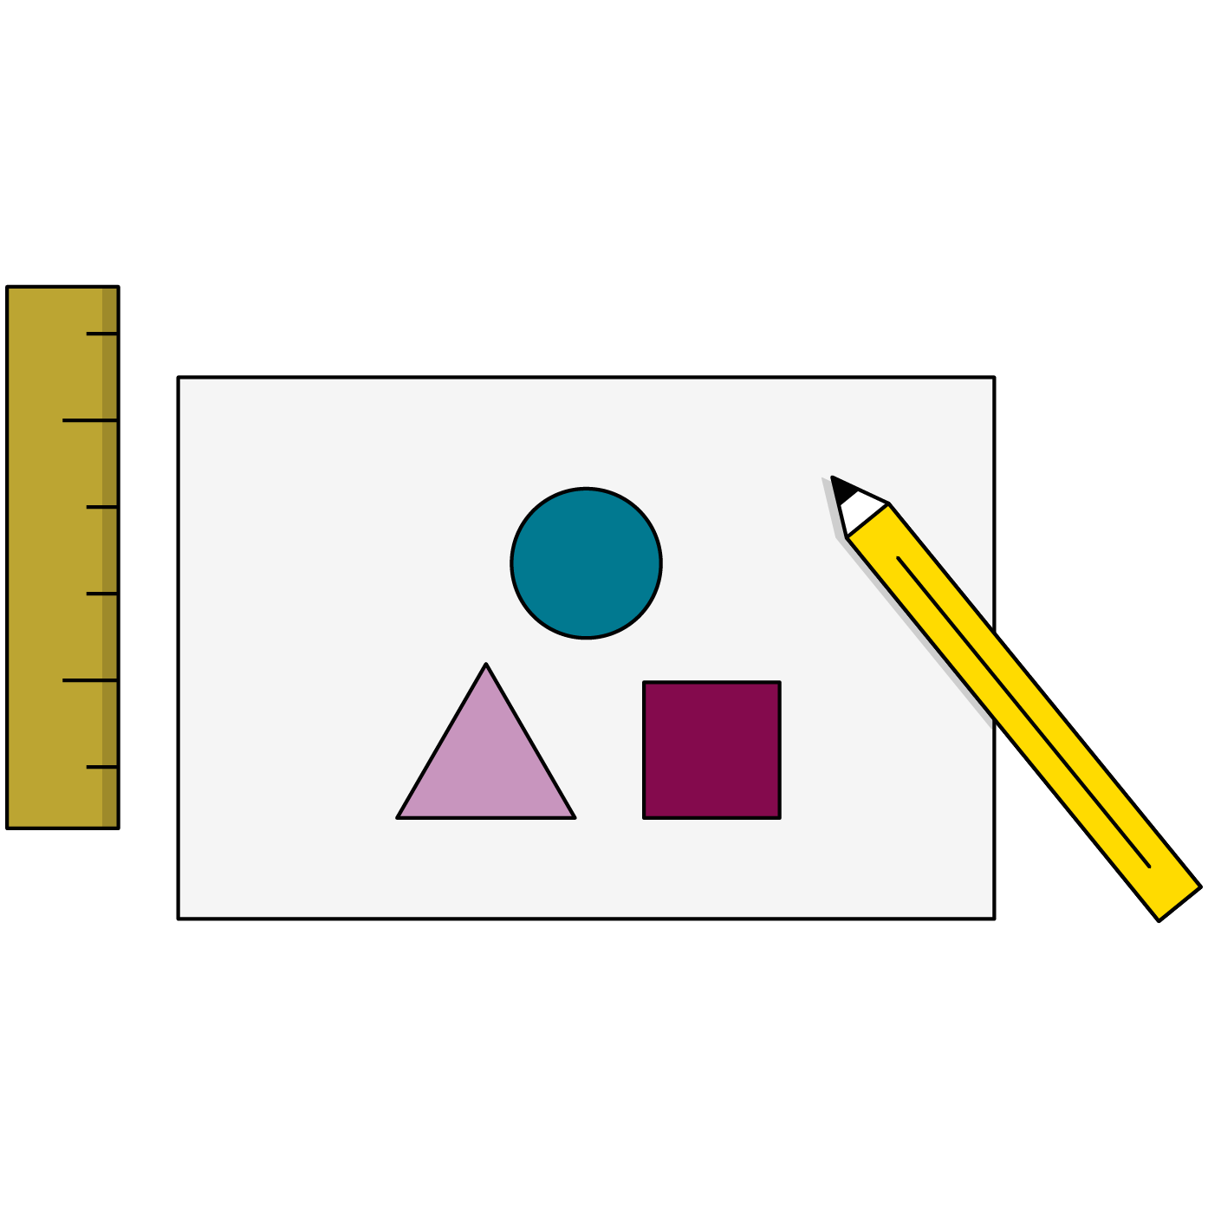
Quick Styling Tips
Always put a new style on a new line.
Try to organize styles logically by section.
Use external style sheets that are linked in the head of your HTML document.
Use whitespace so people can read your code.
Comments are welcome in your CSS.
43 | © 2020 General Assembly

Slide 44
Key Takeaways
For Next Time
CSS Cascades Through the DOM
The CSS Box Model
Style is defined in terms of properties and values.
Using the right selectors can apply consistent styles across the whole page.
Semantic HTML helps coordinate with CSS.
Complete Homework No. 1
The box model defines spacing and sizing of elements.
44 | © 2020 General Assembly

